Slide 1
Managing the Cycle of Escalating Behavior
Understanding and Planning for Escalation in FBA
Portland Public Schools
Presented by Rick Kirschmann
May, 2014

Slide 2
Today
Identify the cycle of escalating behavior
Identify strategies to decrease the occurrence of escalating behavior
Identify ways to intervene during the cycle
Use FBA/BSP to plan for managing escalating behaviors

Slide 3
Expectations
Conversation
Lots! Please be sensitive to cell phones, texting, computer use, and side bar conversation
  Help
  Raise hand, note on the “bike rack”
  Activity
  See Today’s Outcomes
  Movement
  Rule of “Two Feet”
Participation
Fully present and engaged

Slide 4
Teacher | Jason
Jason, please turn in your assignment.
What assignment?
The assignment you didn‘t finish during class.
I finished it.
Great, please turn it in now.
I don’t have it with me now.
You have a choice: turn it in or do it again.
You never believe me.
I guess you’ve made the choice to do it again.
Make me.
That’s disrespect…go to the office.
F_____ you!
Moves closer…& puts hand on J. shoulder.
Pulls away, glares, & raises fist as if to strike.
Notes:
Have you ever experienced or witnessed this?

Slide 5
The Escalation Cycle
High
Peak
Acceleration
De-escalation
Agitation
Trigger
Calm
Recovery
Low
Colvin & Sugai, 1989

Slide 6
Escalating Phases
Peak
  Student is out of control and displays most severe problem behavior
De-escalation
  Student displays confusion but with decreases in severe behavior
Recovery
  Student displays eagerness to participate in non-engagement activities
Calm
  Student is cooperative
Trigger
  Student experiences a series of unresolved conflicts
Agitation
  Student exhibits increase in unfocused behavior
Acceleration
  Student displays focused behavior

Slide 7
Resource

Slide 8
ASSUMPTIONS
Behavior is learned (taught)
Behavior is purposeful (functional)
Behavior is escalated through successive interactions (practice/habits)
Behavior can be changed through an instructional approach

Slide 9
How to Help….
Intervene early in an escalation
Identify environmental factors that can be changed
Teach replacement behaviors

Slide 10
Signs of Escalating Behavior
Arguing
Non-compliance/defiance
Verbal abuse
Disruption
Bothering others
Off-task behavior
Destruction of property
Whining/crying
Limit testing
Threats and intimidation
Escape/avoidance

Slide 11
Strategies for Managing Escalating Behavior
Teacher empathy
Assisting the student to focus on the task
Providing space
Providing assurances and additional time
Permit preferred activities
Teacher proximity
Independent activities
Passive activities
Movement activities
Student self-management when appropriate

Slide 12
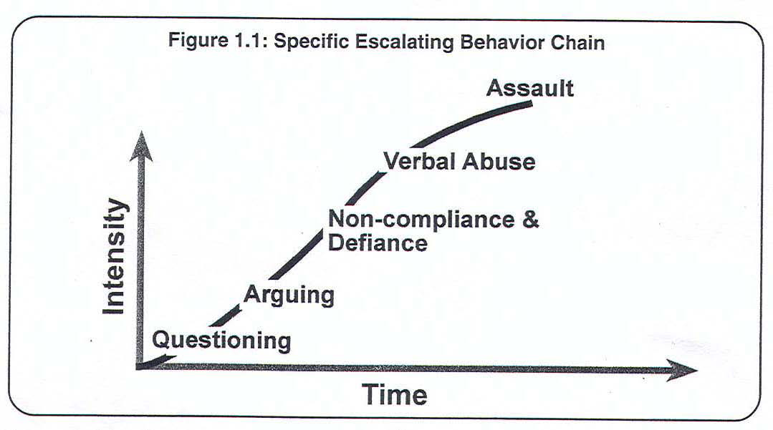
Escalating Chain of Behavior

Slide 13
Successive Interactions
Series of interactions between teacher and student
“My turn-your turn”
Teacher behavior sets the stage for the next student behavior
What if the teacher didn’t take a turn?
Escalating behavior chains –
Lets interrupt the chain of events!

Slide 14
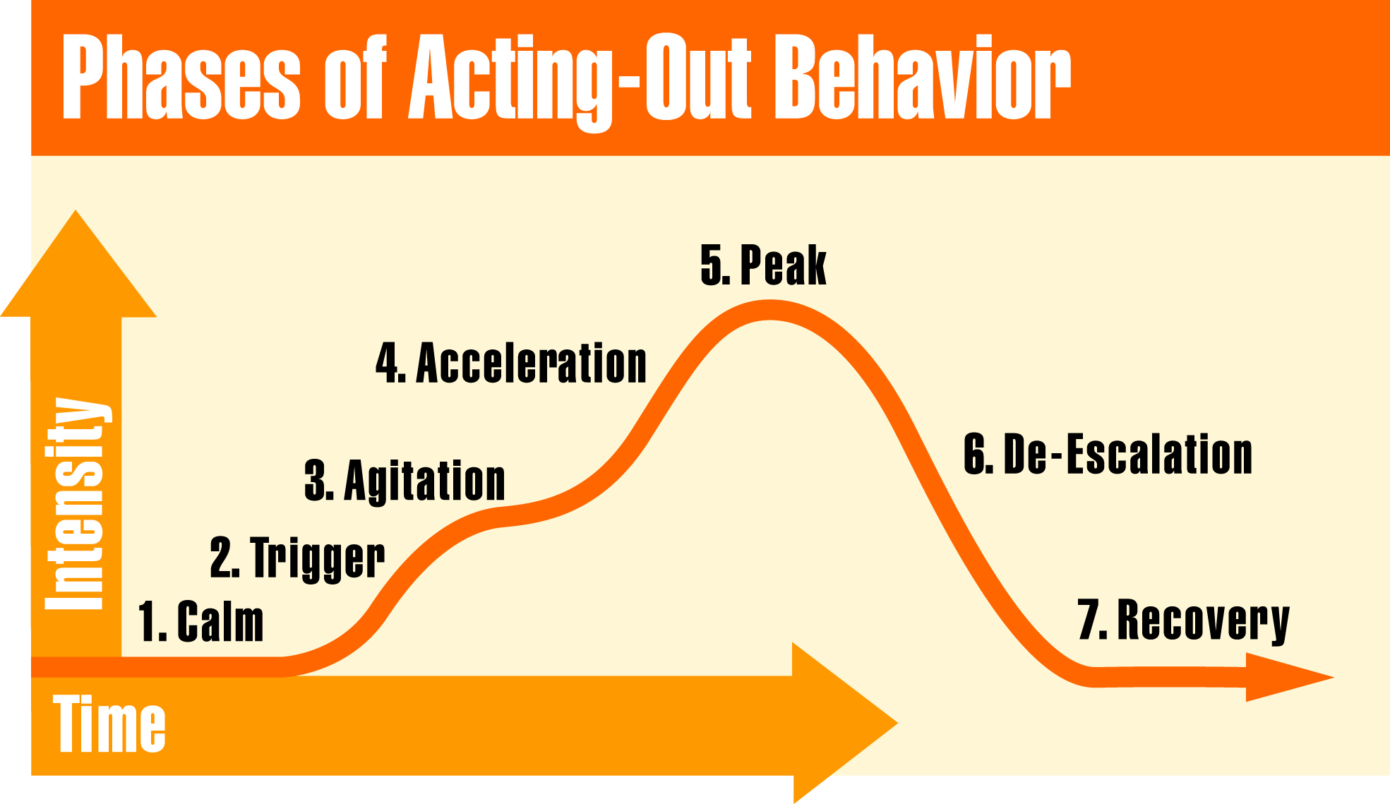
Model for Escalating Behavior Chain

Slide 15
The Model Always Happens
Hgh
Low

Slide 16
Two Components for Managing Escalating Behavior
1. Understand the Model
Patterns
Specific behaviors for each phase
Know where the student is in the cycle
2. Develop Strategies for Each Phase
Implement strategies based on where the student is in the cycle

Slide 17
Understand the Model

Slide 18
Phase One: Calm
Student is cooperative.
Accepts corrective feedback
Follows directives
Sets personal goals
Ignores distractions
Accepts praise
On-task

Slide 19
Phase Two: Trigger
Student experiences a series of
unresolved problems.
Conflicts/Failure
Changes in routine
Pressure
Ineffective problem solving
Facing correction procedures
Non-school based triggers

Slide 20
Phase Three: Agitation
Overall behavior is unfocused and
distracted.
Off-task
Questioning/Arguing
Out of seat
Bothering others
Social withdrawal

Slide 21
Phase Four: Acceleration
Overall behavior is staff-engaging leading to further negative interactions.
Questioning/Arguing/Threats
Noncompliance and defiance
Provocation of others
Rule violations

Slide 22
Phase Five: Peak
Overall behavior is out of control creating safety concerns.
Physical aggression
Severe tantrums
Property destruction
Self-injury
Running, screaming

Slide 23
Phase Six: De-escalation
Overall behavior shows confusion and lack of focus.
Confusion
Withdrawal
Denial
Blaming others
May respond to concrete directions

Slide 24
Phase Seven: Recovery
Overall behavior shows an eagerness for busy work and a reluctance to interact.
Eagerness for independent work
Subdued behavior
Defensive behavior
Sleep

Slide 25
Strategies

Slide 26
Strategies
1. Calm
Intervention is focused on proactive
prevention.
Arrange for high rates of successful academic & social engagements
Use positive reinforcement
Teach skills
Communicate positive expectations

Slide 27
Strategies
1. Calm
Four Strategies:
Classroom Structure (STOIC/CHAMPS)
Quality Instruction (culturally relevant & engaging)
Managing Attention (relationships)
Teaching Behavior

Slide 28
Strategies
2. Trigger
Intervention is focused on prevention and redirection.
Increase opportunities for success
Respond to students exhibiting expected behavior
Reinforce the student’s first on task response
Intermittently reinforce on-task behavior

Slide 29
Strategies
2. Trigger
Three major areas:
Formal programs or services: curriculum interventions, counseling, community services, medical assistance
Pre-Correction: anticipating the problem behavior and intervening beforehand
Addressing non-school based triggers: parent conferences-partnerships, school support services, wrap-around services

Slide 30
Strategies
3. Agitation
Intervention is focused on reducing anxiety.
If not addressed student may escalate or remain distracted
Strategies are accommodations
Implement before onset of escalation

Slide 31
Strategies
3. Agitation
Make environmental modifications
Provide reasonable options & choices
Involve in successful engagement

Slide 32
Strategies
3. Agitation
What to do before a behavior escalates
Achieve eye contact
Use person’s name
Non-verbal signal
Proximity & praise
Reduce distance
Do the unexpected
Give time to think & decide
Give more “start” requests instead of “stop” requests.
Make non-emotional instead of emotional requests
Use the “broken record” technique.

Slide 33
Strategies
3. Agitation
Teacher empathy
Movement activities
Space (jobs)
Options/Choices
Preferred activities
Relaxation techniques
Teacher proximity
Pre-arranged signal
Independent activities

Slide 34
Strategies
3. Agitation
Techniques that backfire:
Raising your voice
Saying “I’m the boss”
Insisting on having the last word
Sarcasm
Nagging
Comparing to others
Drawing others in
Insisting you’re right
Preaching
Assumptions
Non related events
Holding a grudge

Slide 35
Strategies
4. Acceleration
Intervention is focused on safety
Remove all triggering factors
Avoid escalating prompts
Maintain calmness, respect and detachment
Approach the student in a non-threatening manner
Utilize non-confrontational limit-setting

Slide 36
What are Escalating Prompts?
Agitated behavior from staff (shouting)
Cornering the student
Engaging in power struggles
Moving into the student’s space
Touching or grabbing the student
Sudden or very quick responses
Making derogatory statements
Arguing/becoming defensive
Body language that shows anger & frustration

Slide 37
What is a Non-Threatening Manner?
Speak calmly
Speak privately
Minimize body language
Keep a reasonable distance
Speak respectfully and privately
Move slowly and deliberately toward the problem situation

Slide 38
What is a Non-Threatening Manner?
Establish eye level position
Be brief (KISS)
Stay with agenda
Avoid power struggles
Give student space
Do not communicate “urgency to gain control”
Acknowledge cooperation

Slide 39
Strategies
5. Peak
Intervention is focused on safety
Crisis management – NVCI
Implement your plan
  contact the office
  clear the room
DO NOT PROBLEM SOLVE
Encourage Calmness
  Deep breaths
  Sitting down
  “You are not in trouble”

Slide 40
Strategies
5. Peak
Short-term interventions:
Isolation or removal of involved student
Allow time for student to “cool down”
Removal of other students

Slide 41
Strategies
5. Peak
Legal Considerations:
Define Emergency (Safety Plan)
Use of Restraint
Notification/Documentation
Revise FBA/BSP/MEB
Data Collection
Staff Debrief

Slide 42
Strategies
6. De-escalation
Intervention is focused on monitoring for re-escalation of behavior
Monitor for health/safety of all involved
Avoid blaming
Allow time and space
Engage in independent work
Cool-down time
Determine appropriate time to debrief

Slide 43
Strategies
7. Recovery
Intervention focuses on returning to normal activities
Follow through with consequences
Positively reinforce any displays of appropriate behavior
Debrief/rehearse problem solving routine

Slide 44
Strategies
7. Recovery
Effective Consequences
Does the consequence,
Model, instruct or teach a more appropriate behavior?
Interfere with the flow of the lesson?
Give the learner the choice to redirect and receive instruction?

Slide 45
Debriefing Session
Facilitates transition back to class… not further negative consequence.
Goal is to increase appropriate behavior
Focus on problem solving
Pinpoint events that contributed to the incident
Teach replacement behaviors
Debriefing activities and forms

Slide 46

Proactive Strategies
Have school-wide PBIS in place
Emphasize quality instruction leading to increased academic engagement
Emphasize teaching and prevention techniques

Slide 47
Share!

Slide 48



Resources

Slide 49
References
Video: Colvin, G. (2004). Defusing Anger and Aggression. Available from IRIS Media, (877) 343-4747, www.lookiris.com.
Colvin, G (2004). Managing the cycle of acting-out behavior in the classroom. Eugene, Oregon: Behavior Associates.

Slide 50
References (cont.)
Sprague, J. & Golly, A. (2005). Best behavior: Building positive behavior support in schools. Longmont, Colorado: Sopris West.
Sprick, R. Garrison, M. & Howard, L. (1998). CHAMPs: A proactive and positive approach to classroom management. Longmont, CO: Sopris West.

Slide 51
FINAL THOUGHT
It is always important to remember,
“If you inadvertently assist the student to escalate, do not be concerned; you will get another chance to do it right the next time around.”
(Geoff Colvin,1989).

Slide 52
Functional Behavioral Assessment (FBA) & Behavior Support Planning (BSP)
Managing Escalating Behavior

Slide 53
Function Based Approach
Solutions focus on environmental events and skill deficits, not “within person” pathologies
What triggers and maintains the behavior?
How can we proactively prevent the behavior?
What skills does the student lack?
Emphasis is on changing the student’s environment and teaching skills rather than “fixing the person”

Slide 54
Behavior is Functional
It serves a purpose
Obtain or Escape
The consequence or result of a behavior affects the future occurrence of the behavior
Kids figure out how to get their needs met

Slide 55
Functions
Positive Reinforcement
a behavior is strengthened by getting a desired condition
Negative Reinforcement
a behavior is strengthened by stopping an undesirable condition
Problem Behavior
Obtain
Escape
Sensory
Stimulation
Tangible
Activity
Attention
Peer
Adult

Slide 56
Behavior is Predictable
Environmental conditions set-up, set-off, or maintain problem behavior
Antecedents predict when a behavior will occur
Consequences maintain behavior (problem or desired)

Slide 57
Escalating Behavior

Slide 58
FBA Process Has 4 Components
Functional Behavioral Assessment
Behavior Support Plan
Implementation
Monitoring

Slide 59
Behavior is Changeable
Make the problem behavior,
Irrelevant
Inefficient
Ineffective

Slide 60
Information Gathered for FBA
Records Review
ABC Analysis
Routines Analysis
  Behavior Escalation
Interviews
Observations
Consideration of Culture and Context

Slide 61
When Should the BSP Include a Plan for Escalating Behavior?
When a student exhibits challenging behavior which escalates from mild to more intense.

Slide 62
Behavior Support Planning
FBA
BSP
FBA = ALWAYS!!!
BSP = ALWAYS!!!
Plan For Managing Escalating Behavior = Behavior gets intense
Safety Plan = If student needs constant supervision and emergency likely

Slide 63
FBA
&
BSP
Worksheet For Function Based Support

Slide 64
http://ppsfba.weebly.com

Slide 65
A Tool Used in FBA/BSP
Developed During FBA and is ONLY One Part of the BSP

Slide 66
Student’s Escalating Behavior

Slide 67
BSP
Prevention

Slide 68
BSP
Prevention

Slide 69
BSP
Teach

Slide 70
BSP
Teach
Plus Long Term Skill

Slide 71
BSP
Correct & Reinforce

Slide 72
BSP
Correct & Reinforce

Slide 73
Resources
Extras and Ideas

Slide 74


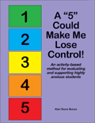

Slide 75
Progressive Break Plan

Slide 76
Verbal
De-escalation
Techniques

